Slide 1
Linux Privilege Escalation
Presented By: Hassan Al Achek

Slide 2
What is the goal of privilege escalation?
Our ultimate goal with privilege escalation in Linux is to gain a shell running as the root user.
Privilege escalation can be simple (e.g. a kernel exploit) or require a lot of reconnaissance on the compromised system.

Slide 3
Understanding Permissions in Linux:
permissions in Linux is a relationship between users, groups, files and directories.
users: multiple groups
groups: multiple users
Every file and directory defines its permissions in terms of a user, a group, and "others"(all users).

Slide 4
Users:
The core of the Linux security system is the user account
Each individual who accesses a Linux system should have a unique user account assigned
The users’ permissions to objects on the system depend on the user account they log in with
User permissions are tracked using a user ID (often called a UID), which is assigned to an account when it’s created
The Linux system uses special files and utilities to track and manage user accounts on the system.
The root user is a special type of account in linux system (with UID 0)

Slide 5
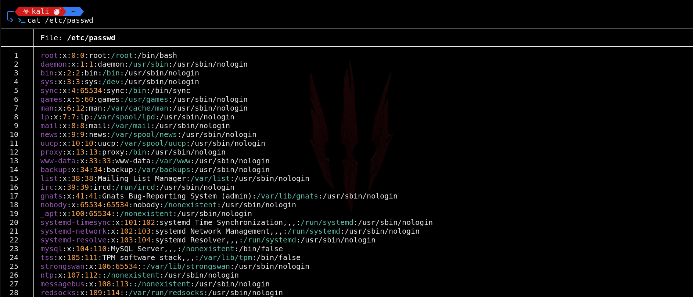
/etc/passwd file
Notes:
1- The Linux system uses a special file to match the login name to a corresponding UID
value. This file is the /etc/passwd file. The /etc/passwd file contains several pieces of
information about the user. Here’s what a typical /etc/passwd file looks like on a Linux System.
2- the Linux system creates lots of user accounts for various functions
that aren’t actual users.

Slide 6
/etc/passwd
User Name
password
UID
GID
a text description
HOME directory
Shell
Notes:
1- UID < 500 reserved for system accounts

Slide 7

/etc/shadow
But wait Hassan, is the password ‘x’ for all users
:) wait let’s discuss the /etc/shadow

Slide 8
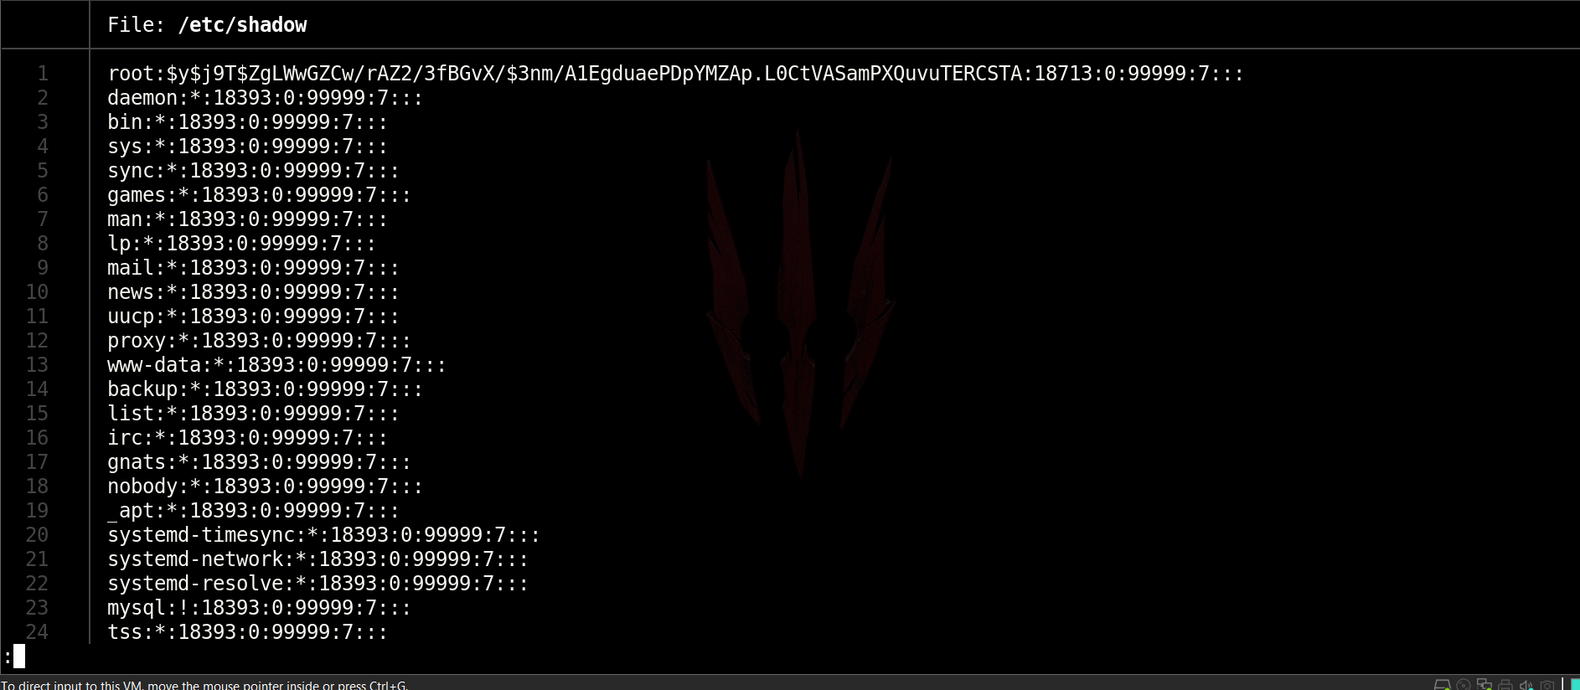
/etc/shadow
Notes:
1- Can only accessed by the root user
2- Only special programs (such as the login program) are allowed access to this file

Slide 9
/etc/shadow
Login Name
The Encrypted Password
Notes:
1- The day the password was last changed, depicted as the number of days since January 1, 1970
2- useradd: add user
3- userdel: delete user

Slide 10
Groups
Group permissions allow multiple users to share a common set of permissions for an object on the system, such as a file, directory, or device
Each group has a unique GID, which, like UIDs, is a unique numerical value on the system. Along with the GID, each group has a unique group name.
Groups are configured in the /etc/group file
Notes:
1- groupadd

Slide 11
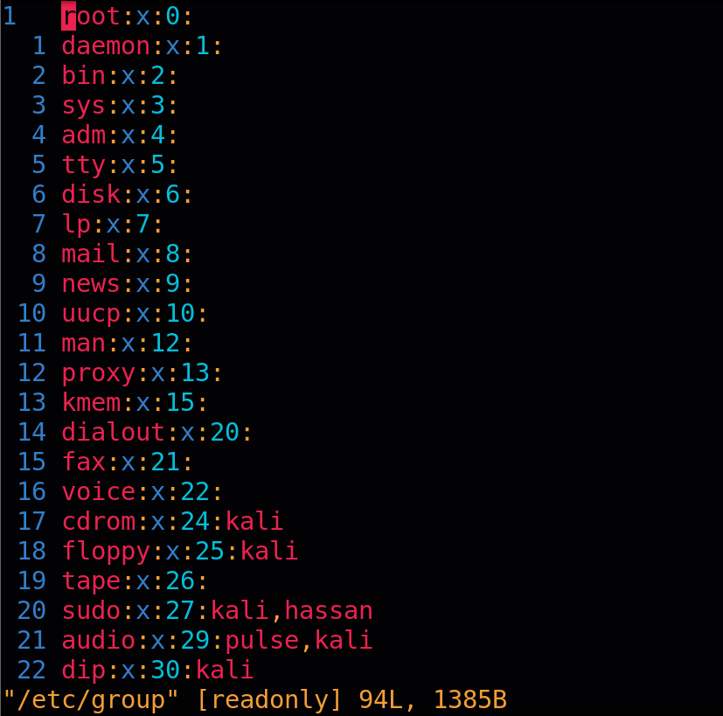
/etc/group

Slide 12
/etc/group
Group Name
Group Password
Group ID (GID)
Uses in the group
Note: The group password allows a non-group member to temporarily become a member of the group by using the password.

Slide 13
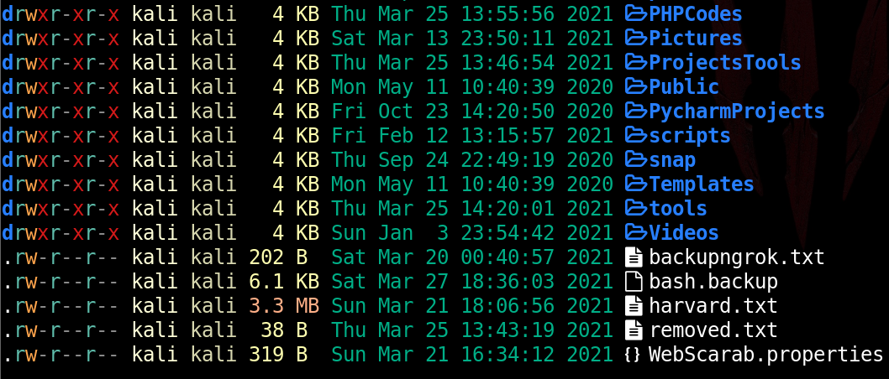
Files
To list file permission we will use ls -l command

Slide 14
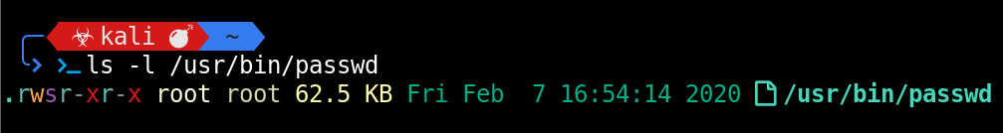
Files
- file, d directory
owner
group
others
Note: Only owner of the file can change permissions
All files & directories have a single owner and a group

Slide 15
File Permissions
Read - r - when set, the file contents can be read
Write - w - when set, the file contents can be modified
Execute - x - when set, the file can be executed (i.e. run as some kind of process)
Notes:
1- umask: command to set default file permissions
0022
2-
For file: 666 - 022
For directory: 777 - 022
3- chmod: symbolic
[ugoa...][[+-=][rwxXstugo...]

Slide 16
Directory Permission
Execute – when set, the directory can be entered. Without this permission, neither the read nor write permissions will work
Read – when set, the directory contents can be listed
Write – when set, files and subdirectories can be created in the directory

Slide 17
SUID and SGID
The set user id (SUID): When a file is executed by a user, the program runs under the permissions of the file owner.
The set group id (SGID): For a file, the program runs under the permissions of the file group. For a directory, new files created in the directory use the directory group as the default group.
SUID/SGID permissions are represented by an 's' in the execute position.

Slide 18
Real, Effective, and Saved UID/GID
Each user has three user IDs in Linux (real, effective, and saved)
Real user ID: is who they actually are (check /etc/passwd)
Effective user ID: is normally equal to their real ID, however when executing a process as another user, the effective ID is set to that user's real ID.
the effective ID is used in most access control decisions to verify a user, and commands such as whoami use the effective ID.
Saved user ID: is used to ensure that SUID processes can temporarily switch a user's effective ID back to their real ID and back again without losing track of the original effective ID.

Slide 19
Print real and effective user / group IDs:

Slide 20
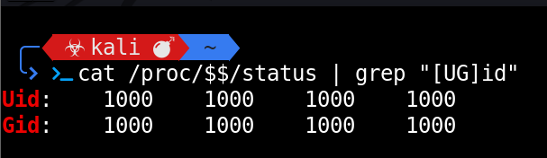
Print real, effective, saved, and file system user / group IDs of the current process (i.e. our shell):

Slide 21
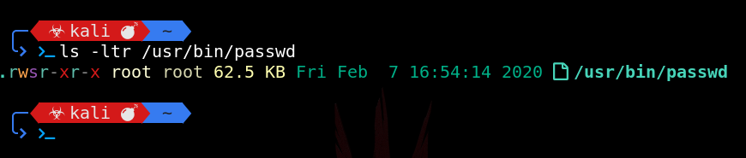
Viewing Permission

Slide 22
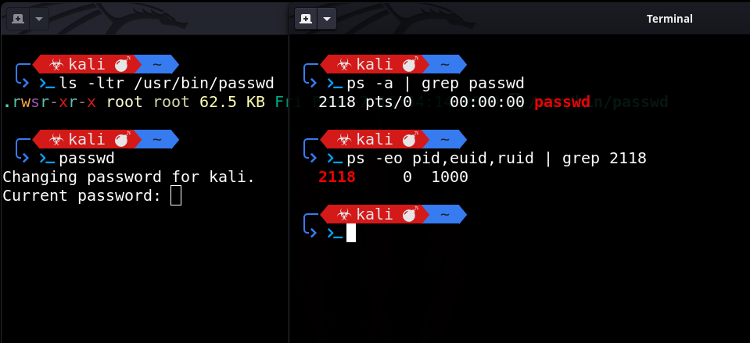
EUID and RUID

Slide 23
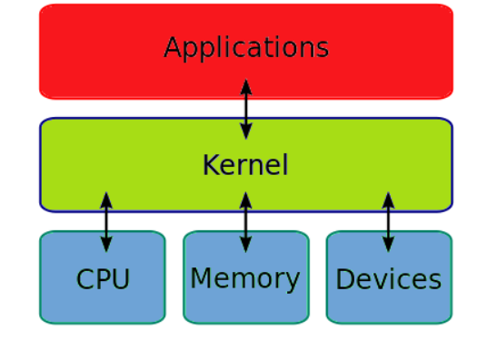
Kernel Exploitation
What is Kernel?
Kernels are the core of any operating system.
Think of it as a layer between application software and the actual computer hardware.
The kernel has complete control over the operating system.
Exploiting a kernel vulnerability can result in execution as the root user.

Slide 24



How To Find Kernel Exploitation?
Enumeration of kernel version (uname -a)
Search for exploit (google, exploit database, or using searchsploit )
Compile and run
Get Root privilege or Crash the system :)
Notes:
Exploit Database - Exploits for Penetration Testers, Researchers, and Ethical Hackers (exploit-db.com)
Google
Google Hacking Database (GHDB) - Google Dorks, OSINT, Recon (exploit-db.com)
https://book.hacktricks.xyz/linux-unix/privilege-escalation

Slide 25
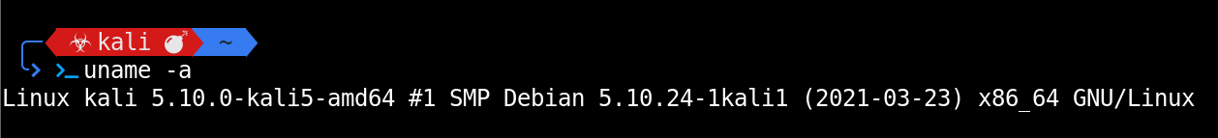

Enumeration
Searchsploit

Slide 26


Slide 27
Links
Dirty Cow: PTRACE_POKEDATA variant of CVE-2016-5195 · GitHub
Linux exploit suggester 1: GitHub - mzet-/linux-exploit-suggester: Linux privilege escalation auditing tool
Linux exploit suggester 2: GitHub - jondonas/linux-exploit-suggester-2: Next-Generation Linux Kernel Exploit Suggester

Slide 28


Dirty Pipe - CVE-2022-0847

Slide 29

Weak File Permissions
Certain system files can be taken advantage of to perform privilege escalation if the permissions on them are too weak.
If a system file has confidential information we can read, it may be used to gain access to the root account.
If a system file can be written to, we may be able to modify the way the operating system works and gain root access that way.

Slide 30
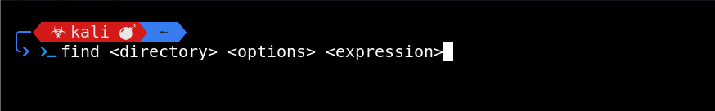


Find Command And Manual Enumeration
Notes:
find / -perm -4000 2>/dev/null #Find all SUID binaries

Slide 31
Find Command And Manual Enumeration
Find writable file: find /etc -maxdepth 1 -writable -type f
Find readable file: find /etc -maxdepth 1 -readable -type f
Find all directories which can be written to:
find / -executable -writable -type d 2> /dev/null

Slide 32


Readable /etc/shadow
By Default Readable by root only
If we are able to read the content of /etc/shadow
We can try to crack the hash of the root user
Using HashCat or John
john --format=sha512crypt --wordlist=/usr/share/wordlists/rockyou.txt hash.txt

Slide 33
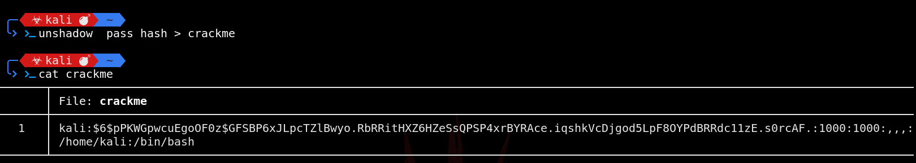
Readable /etc/shadow
~# unshadow passwd shadow > crackme
~# john --wordlist<=custom wordlist file> <file to crack>
~# john --wordlist=/usr/share/wordlists/rockyou.txt crackme

Slide 34
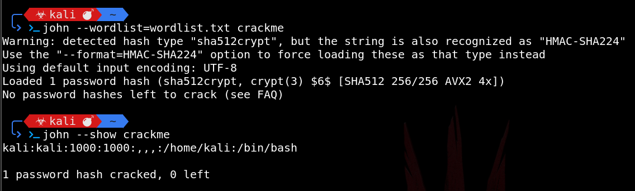
Readable /etc/shadow

Slide 35
Writable /etc/shadow
Generate a new SHA-512 password hash:
~# mkpasswd -m sha-512 newpassword
Edit the /etc/shadow and replace the root user’s password hash with the one we generated.
~# su #switch user

Slide 36
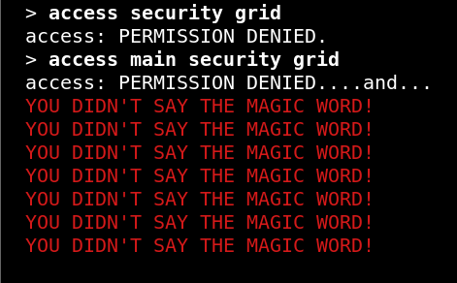
Sudo
What is sudo?
sudo is a program which let users run other programs with the security privileges of other user. By default, that other user will be root.
A user generally needs to enter their password to use sudo, and they must be permitted access via rule(s) in the /etc/sudoers file.
List programs a user is allowed (and disallowed) to run:
~$ sudo -l

Slide 37
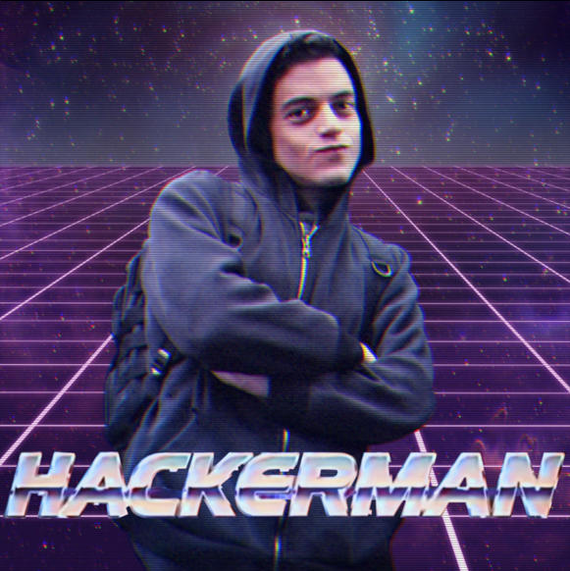
Known Password
~$ sudo su
Password:
~# whoami
Root
~#

Slide 38
If su program is not allowed
~$ sudo -s # -s for shell
~$ sudo -i # -i run login shell as the target user
~$ sudo /bin/bash # run the /bin/bash
~$ sudo passwd # passwd run passwd

Slide 39
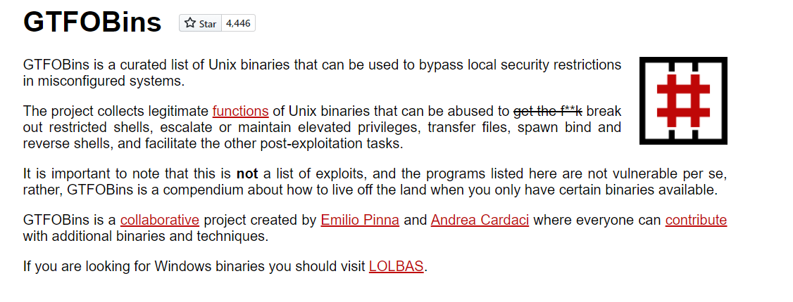
Shell Escape Sequences
GTFOBins
Even if we are restricted to running certain programs via sudo, it is sometimes possible to “escape” the program and spawn a shell.

Slide 40
SUID and SGID Executable
SUID files get executed with the privileges of the file owner.
SGID files get executed with the privileges of the file group.
If the file is owned by root, it gets executed with root privileges, and we may be able to use it to escalate privileges.
We can use the following find command to locate files with the SUID or SGID bits set:
~$ find / -type f -a \( -perm -u+s -o -perm -g+s \) -exec ls -l {} \; 2> /dev/null

Slide 41

Cron Jobs
Cron jobs are programs or scripts which users can schedule to run at specific times or intervals.
Cron jobs run with the security level of the user who owns them.
By default, cron jobs are run using the /bin/sh shell, with
limited environment variables.

Slide 42

Cron Jobs
Cron table files (crontabs) store the configuration for cron jobs.
User crontabs are usually located in /var/spool/cron/ or /var/spool/cron/crontabs/
The system-wide crontab is located at /etc/crontab.

Slide 43
File Permissions
Misconfiguration of file permissions associated with cron jobs can lead to easy privilege escalation.
If we can write to a program or script which gets run as part of a cron job, we can replace it with our own code.
View the contents of the system-wide crontab:
~# cat /etc/crontab

Slide 44


Try Hack Me Room
https://tryhackme.com/room/linuxprivesc
Create Account
Download Vpn Configuration File
Run sudo openvpn username.ovpn
Verify Connection by typing ifconfig tun0 or ip a show dev tun0
SSH: ssh username@targetIp then enter password
Get SSH Session Enjoy ;)

Slide 45
Thanks You :)

Slide 46
Tools For Automation
GitHub - diego-treitos/linux-smart-enumeration: Linux enumeration tool for pentesting and CTFs with verbosity levels
GitHub - rebootuser/LinEnum: Scripted Local Linux Enumeration & Privilege Escalation Checks
GTFOBins
Bash scripting: https://devhints.io/bash
GitHub - sagishahar/lpeworkshop: Windows / Linux Local Privilege Escalation Workshop
privilege-escalation-awesome-scripts-suite/linPEAS at master · carlospolop/privilege-escalation-awesome-scripts-suite · GitHub

Slide 47
Chapter 7: Understanding Linux File Permissions
https://www.wiley.com/en-us/Linux+Bible%2C+10th+Edition-p-9781119578895
Best Hacking Tricks Collection:
https://book.hacktricks.xyz/linux-unix/privilege-escalation
A tool to generate various ways to do a reverse shell
https://github.com/mthbernardes/rsg.git
Manual Enumeration
https://blog.g0tmi1k.com/2011/08/basic-linux-privilege-escalation/
https://github.com/swisskyrepo/PayloadsAllTheThings/blob/master/Methodology%20and%20Resources/Linux%20-%20Privilege%20Escalation.md

Slide 48
Dirty Pipe:
https://dirtypipe.cm4all.com/
https://www.hackthebox.com/blog/Dirty-Pipe-Explained-CVE-2022-0847
https://github.com/Arinerron/CVE-2022-0847-DirtyPipe-Exploit

